Slide 1
Deepfakes: when seeing is no longer believing
Ignas Kalpokas, PhD
Associate Professor, Department of Public Communication, Vytautas Magnus University

Slide 2
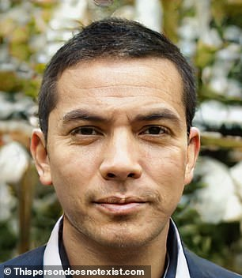
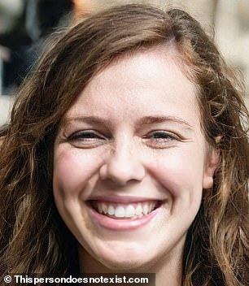
The development of Artificial Intelligence and related technologies brings about a new generation of threats
Creation of synthetic photos and videos
Artificial content that is increasingly inseparable from the real thing
These people do not exist!

Slide 3
A portmanteau of ‘deep learning’ and ‘fake’
Generative Adversarial Network (GAN) –
Showing events that never took place
More than 90% of deepfake content is porn

Slide 4
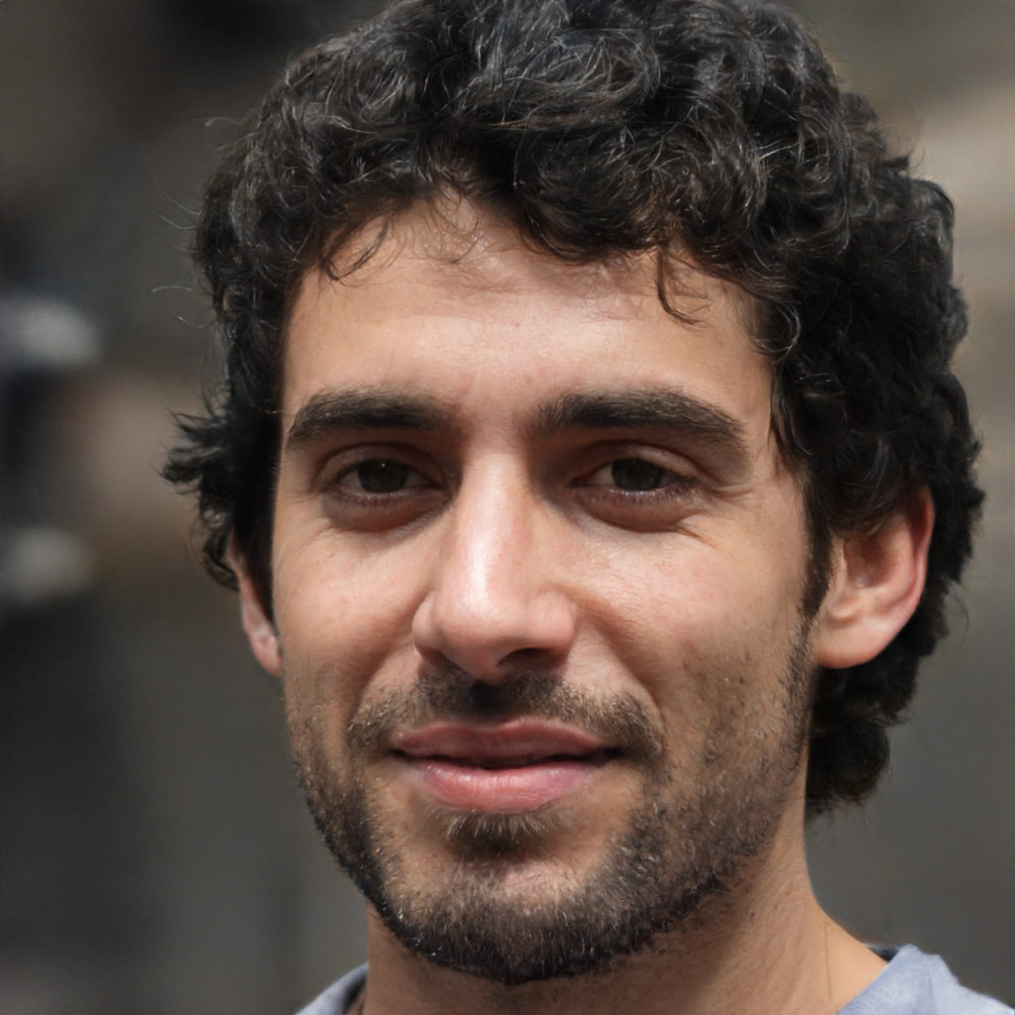
These people do not exist either!

Slide 5
Portraying politicians doing things they did not do
Liar’s dividend
Social engineering
Harassment of activists

Slide 6
Deepfake porn is more than meets the eye
Political aspect
Psychological aspect
Revenge porn
Entrenchment of toxic gender stereotypes

Slide 7
Democratisation of fakes
Accessibility: of technology and material
Today’s online culture is primarily visual: but seeing is no longer believing!
Long-term effect?

Slide 8
What’s next?
‘Infocalypse’, a death blow to truth etc.?
A new era of disinformation?
Loss of trust?
Epistemic (knowledge) anarchy

Slide 9
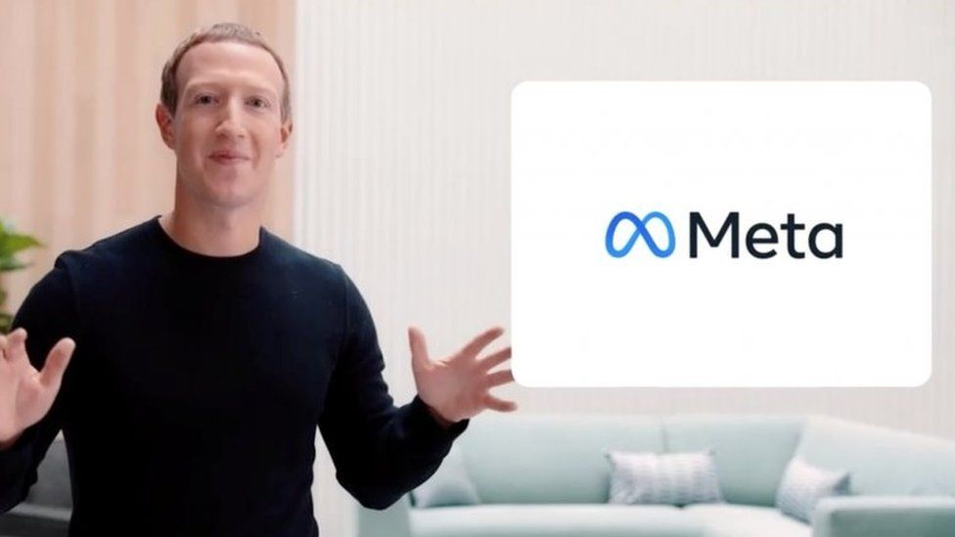
Introducing synthetic experiences on steroids!

Slide 10
