Slide 1
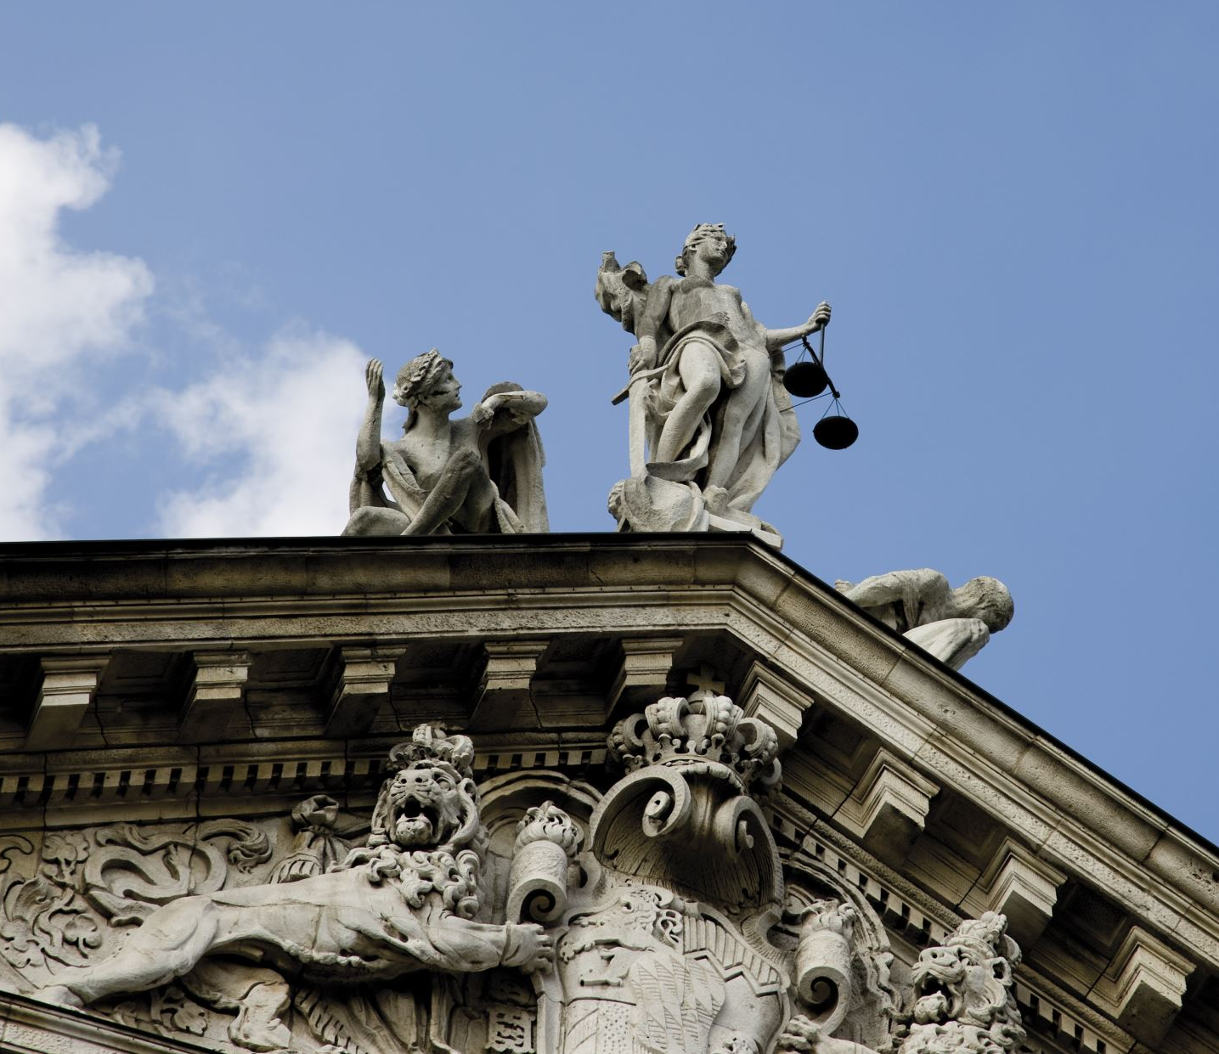
Post-Truth and Manipulation
Ignas Kalpokas, PhD
Associate Professor, Department of Public Communication, Vytautas Magnus University

Slide 2
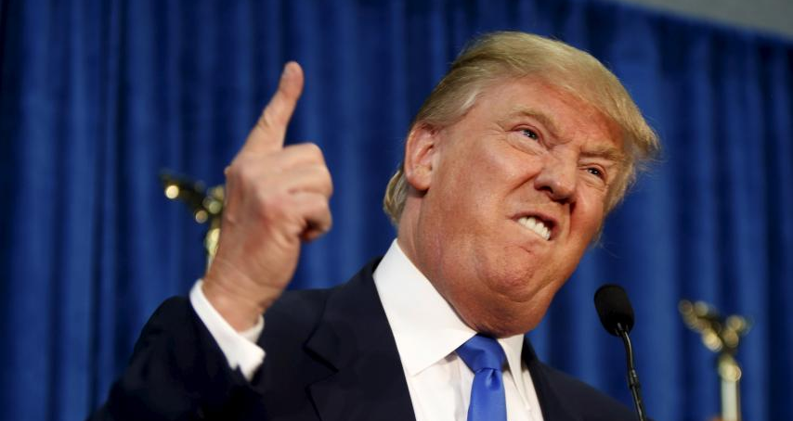
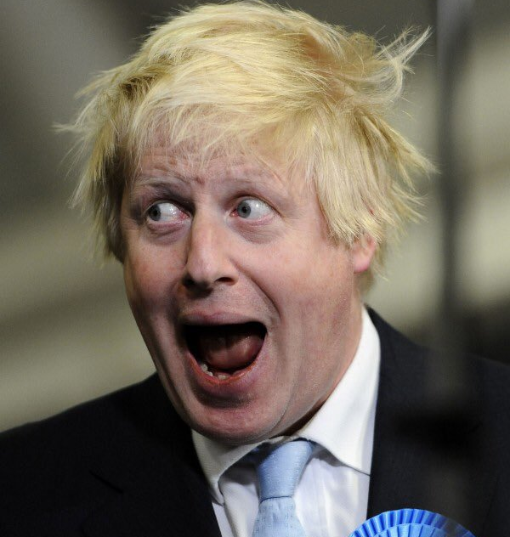

Slide 3
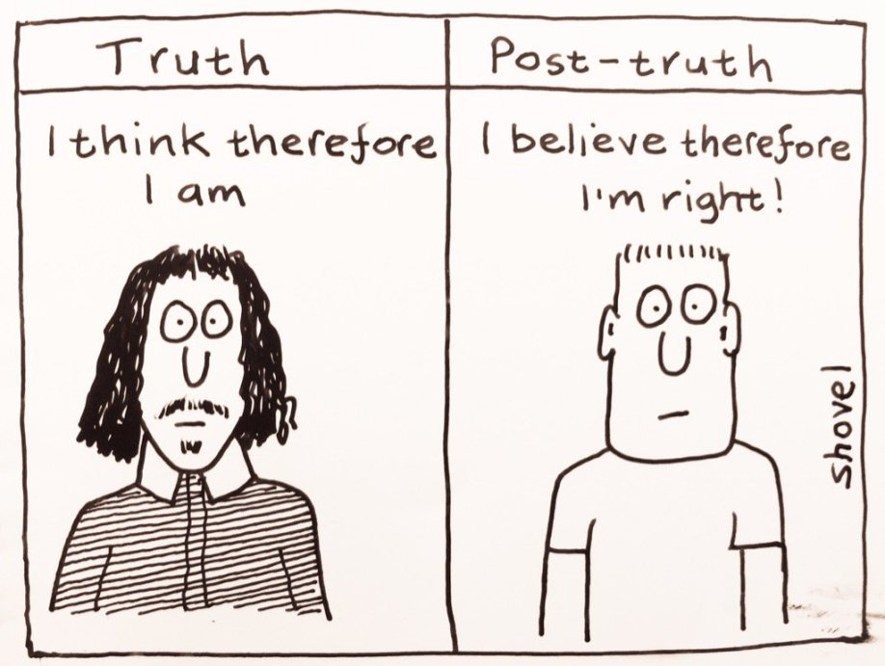

Slide 4
What is Post-truth?
‘qualitatively new dishonesty on the part of politicians’ (Mair 2017: 3)
Statements are made simply because they fit the agenda
Efficiency in asserting one’s claim is the key criterion for the veracity of a claim
Taken up by the audiences because they want it to be true
Post-truth as a collusion between the audiences and the communicators

Slide 5
Post-truth is not about mere routinisation of lies
Post-truth refers to the erasure of the distinction between truth and falsehood
The aspirational nature of post-truth

Slide 6
Economy of thinking
Freedom of narrative choice in a crowded market

Slide 7
People are empowered to choose what truth is for them
If truth is a matter of choice, then changing the minds of people is close to impossible
You can choose to ignore the reality you do not like

Slide 8
Imaginary confirmation
People are more likely to believe something if they think others do as well
Social media ‘filter bubbles’

Slide 9
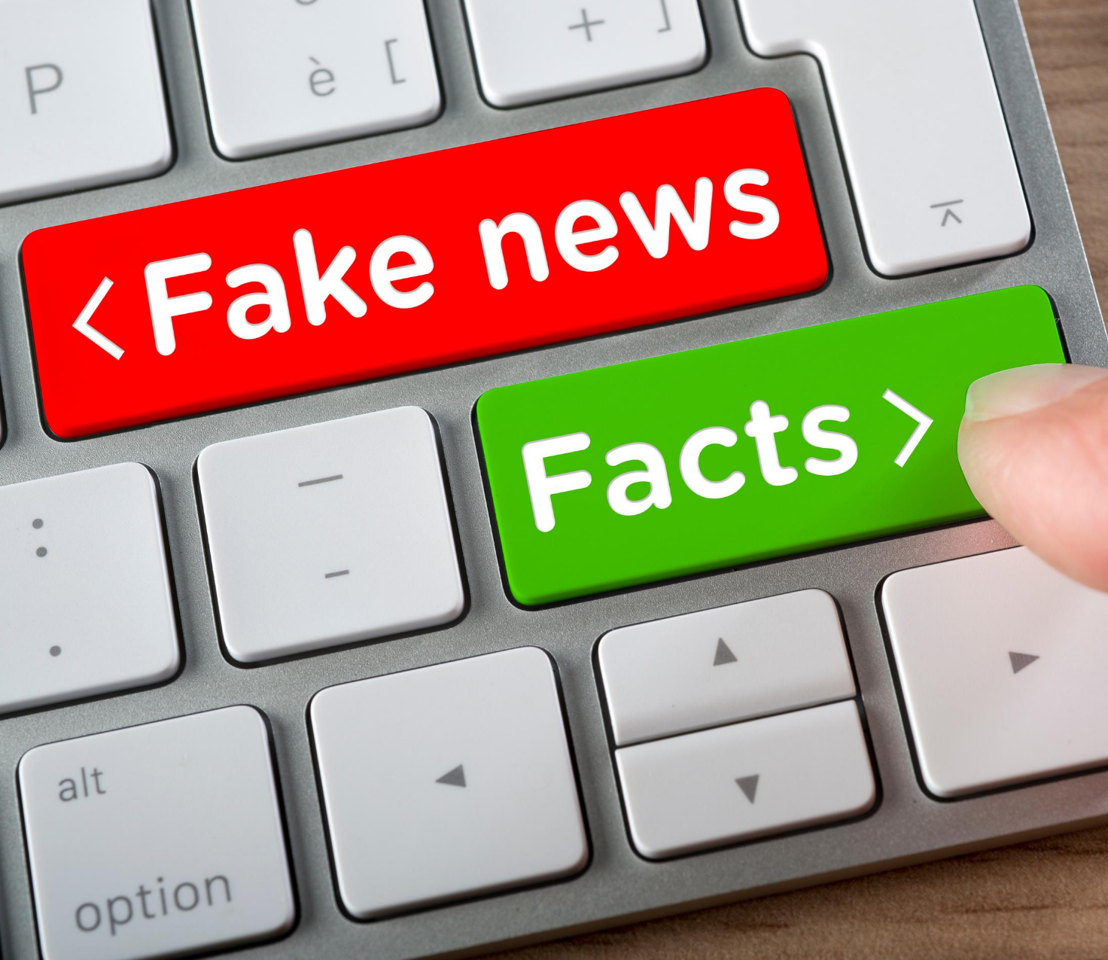
The importance of popularity metrics
But are they really trustworthy?
Bots
Astroturfing

Slide 10
Once a belief takes hold, audiences will themselves start filtering messages and claims
People have a propensity to pay attention only to what confirms their pre-existing beliefs
Vestiges of false beliefs remain even after the information has been demonstrated to be false
An attempt to change opinion can give the opposite result- deeper entrenchment

Slide 11
The importance of pleasure and satisfaction
The narrative does not have to be pleasurable in itself
The pleasure is in the feeling that you have been right all along
Especially among marginalised groups

Slide 12
