Slide 1
Social media and social engineering
Ignas Kalpokas, PhD
Associate Professor, Department of Public Communication, Vytautas Magnus University

Slide 2
Have you ever done things you had rather not done?
Have you done them on social media?
Have you been provoked to do that?
Was that even a human being?

Slide 3
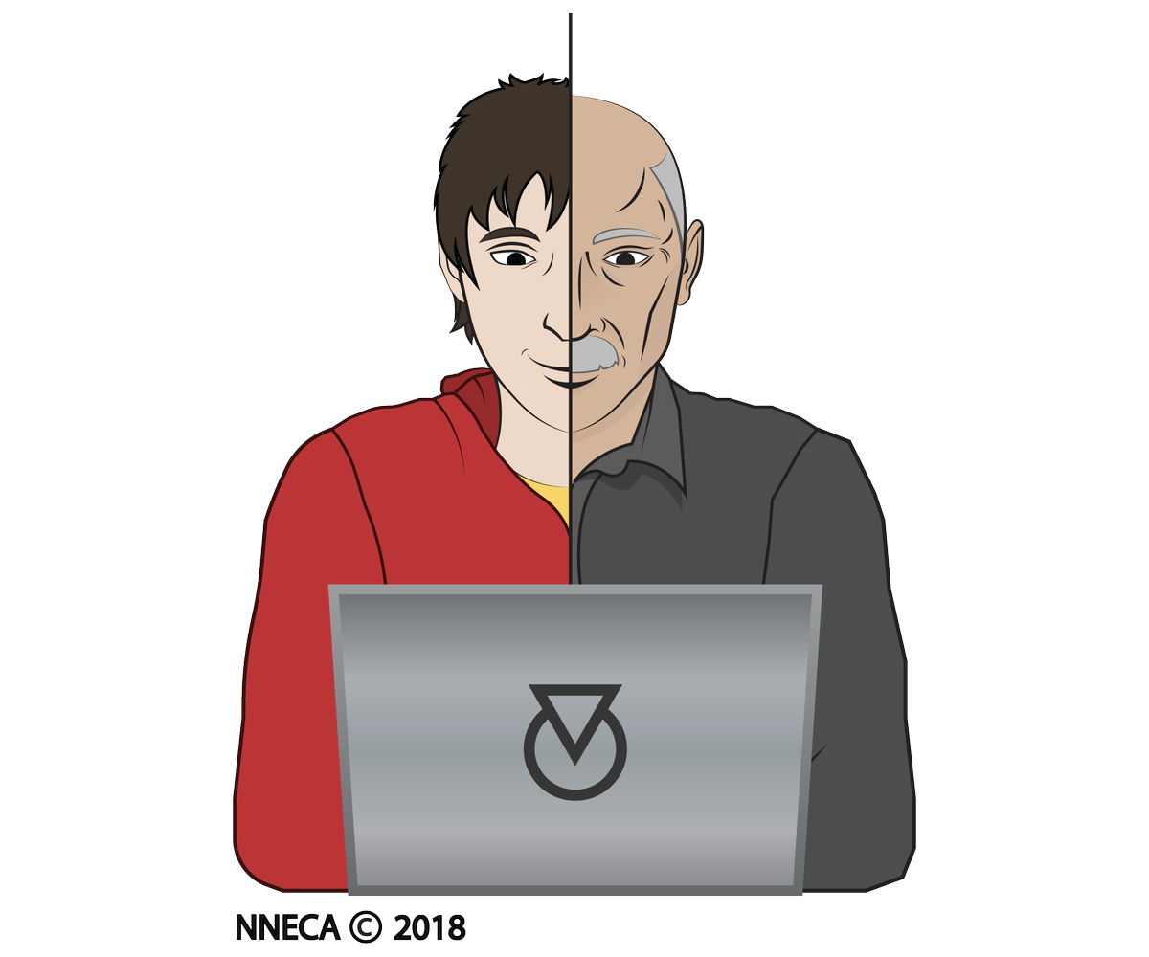
Harassment to sexting to grooming

Slide 4
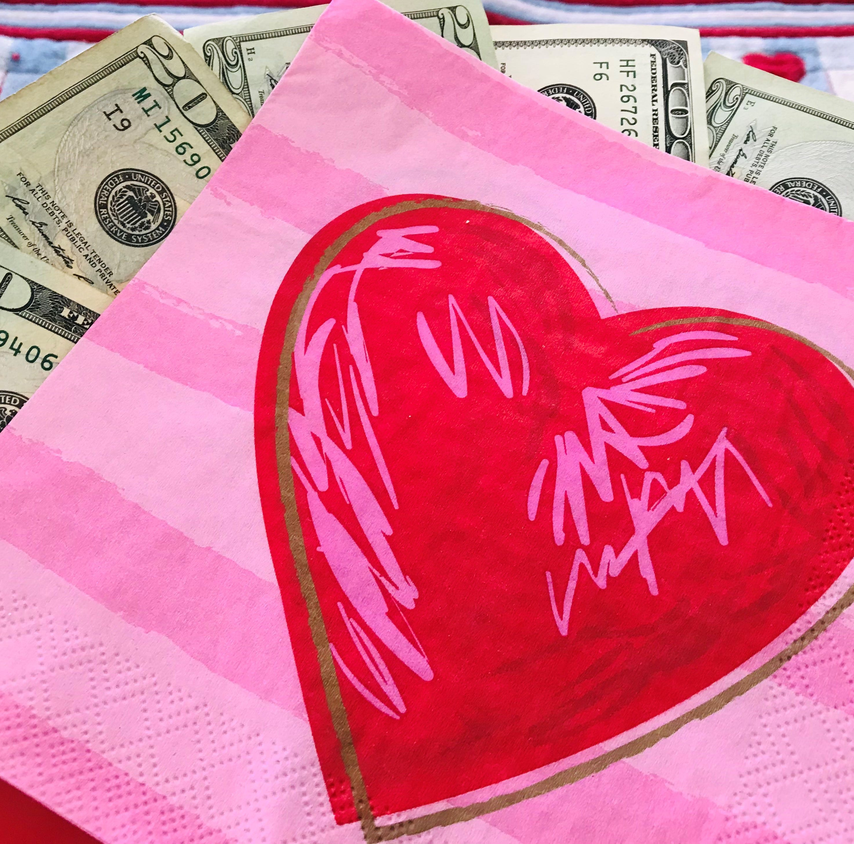
Or maybe you received that invitation to a sexy chat on WhatsApp and there’s a hyperlink?
Or you go all the way and get too involved?
Sextortion

Slide 5
Identity theft
The stuff you reveal
Not just property
Moving on to extortion

Slide 6
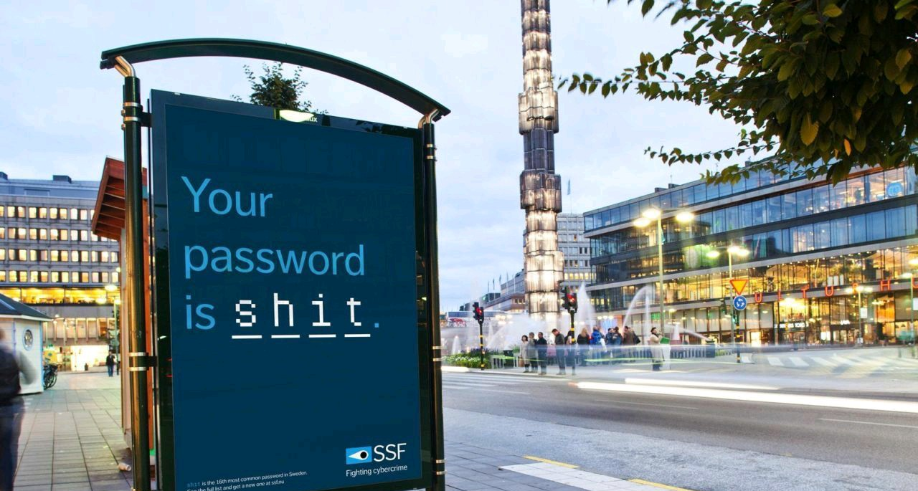
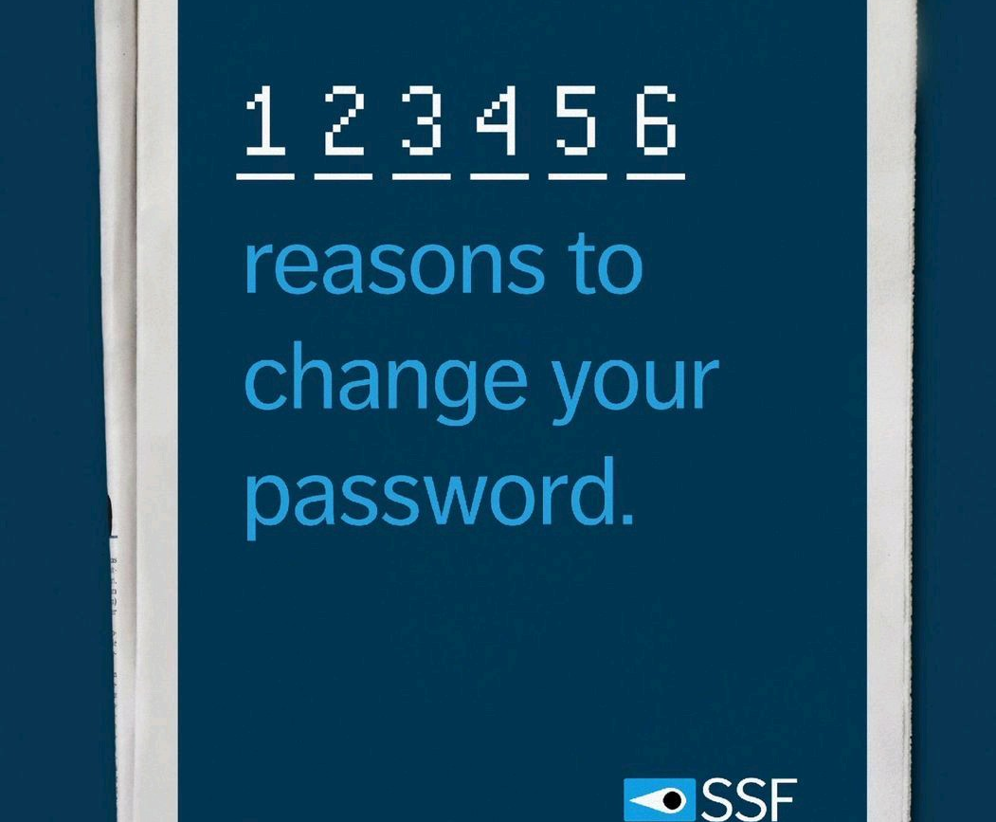
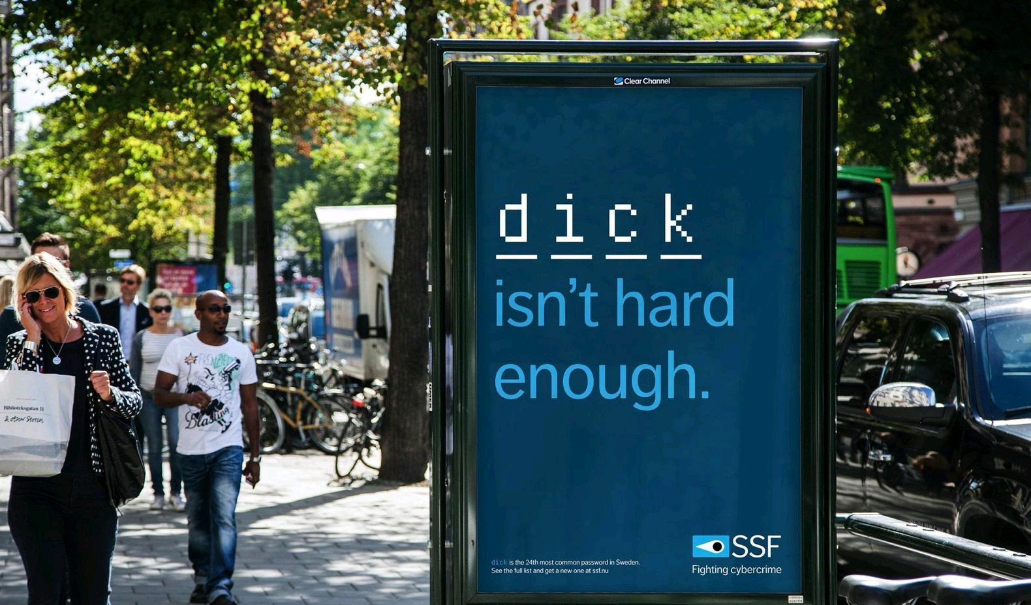
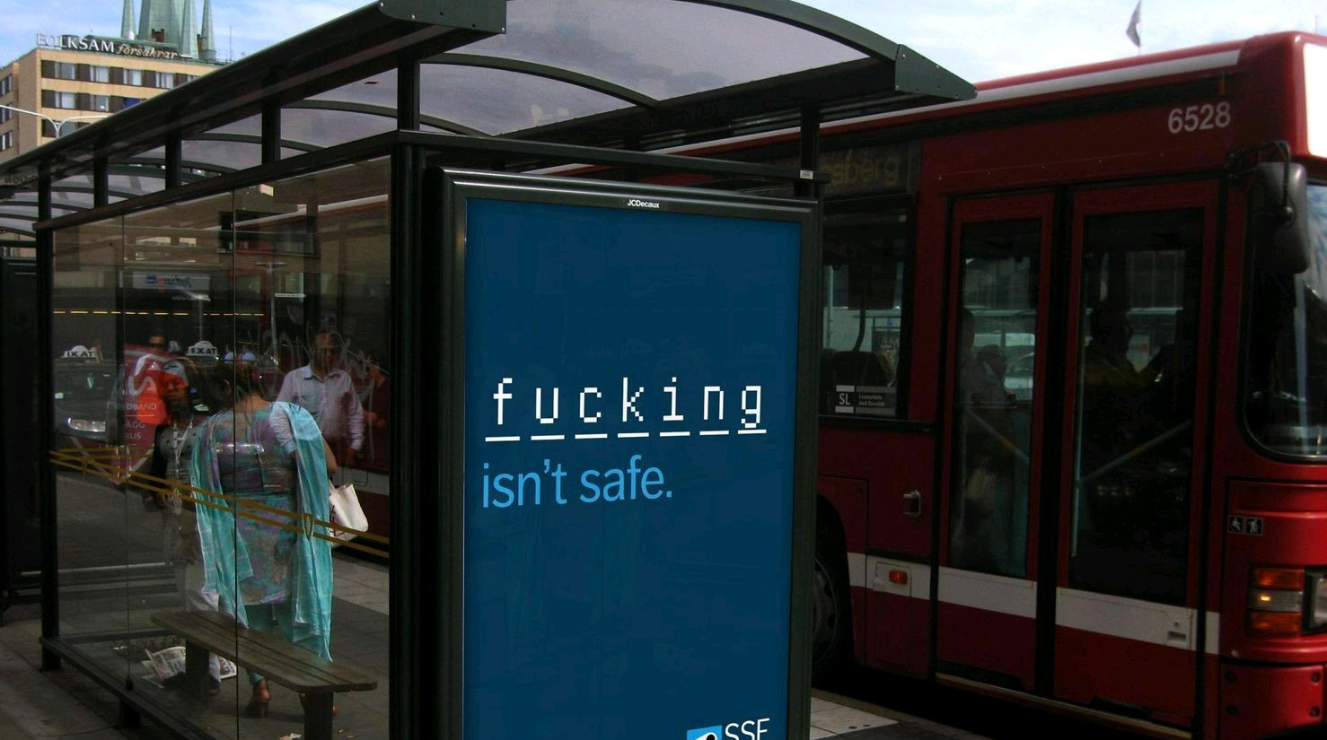
Passwords!
This is an actual password security awareness campaign

Slide 7
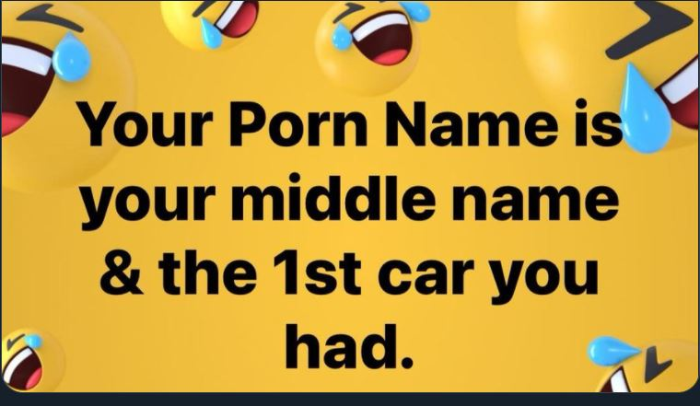
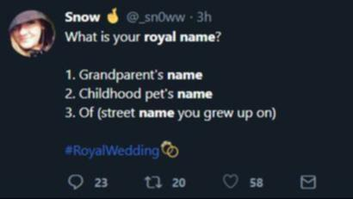
Tricking you to reveal your password
E.g. through bogus messages
Bogus games / challenges put data at risk
‘Your porn name is the name of your first dog and the make of your first car and the street you grew up on’

Slide 8
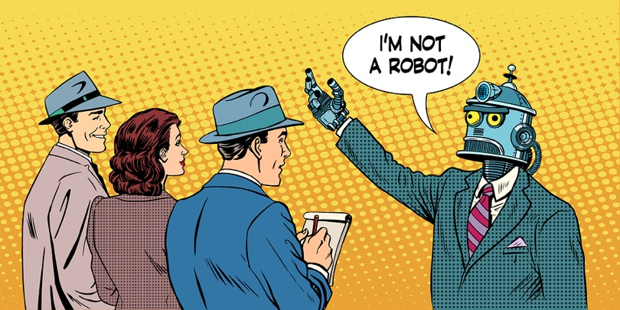
But the scammers cannot be so active!
That’s because what you see is not what you get
Bots and other automated tools

Slide 9
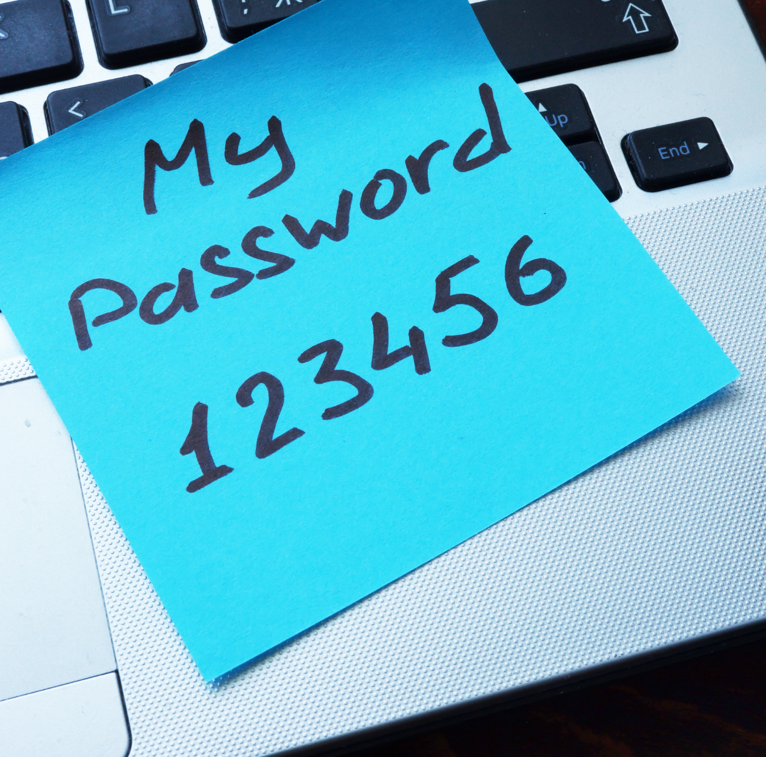
You just had that one password to protect…
Wrong!!!
They’re going to get EVERYTHING
Do you even remember all the placed where you’ve hit ‘Log in with Facebook / Google’?
Tracking by Big Tech might be the least of your worries

