Slide 1
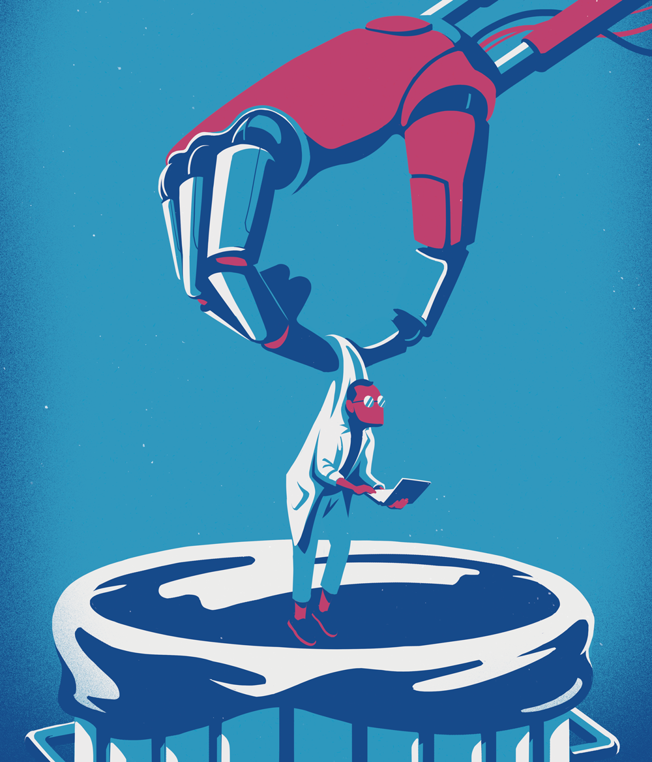
Chapter 1:
Artificial Intelligence
Notes:
https://www.pinterest.fr/pin/34973334585819453/

Slide 2
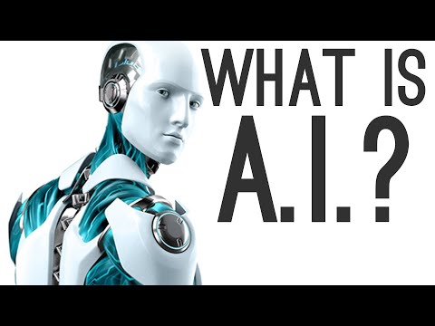
AI : historical, target, purpose, capabilities
Is a machine able to think ?
Could it be considered as “intelligent” and have a kind of language, without thinking beforehand?

Slide 3
Can we use the same weapon, but with a purpose diametrically towards another end?
Is born a concept: the one of Friendly artificial intelligence ; that means getting position in the use of AI in a friendly way.
Bring the use of AI into line with our intention.

Slide 4
What we didn’t showcase yet, are the capabilities of AI regarding the self-improvement of writers, journalists and so on.
You have as a project to become journalists, don’t you?
So, to be exposed in a field of which the main purpose is to share information...
Notes:
https://www.istockphoto.com/illustrations/self-improvement

Slide 5
How to be completely protected against pitfalls and mistakes?
It is exactly in this direction that the use of AI in a friendly way suddenly becomes meaningful.
Because it allows you the possibility to improve yourself, to improve your skills in regard to your writing, the choice of words, sentence structure, and so on.
Notes:
https://www.istockphoto.com/illustrations/self-improvement

Slide 6
2001, Stanley Kubrick, 1968

Slide 7
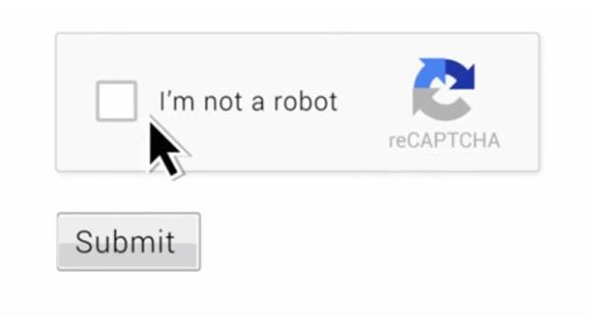
2. Different useful tools
Don’t you think it is a little strange to sometimes attest before entering in some websites that we are not robots, and to affirm that to a robot itself?

Slide 8
Imagine a Machine, which is trying to pretend it has a human intelligence…
Knowing that we are, ourselves, also Human…
This would amount to trying to speak with robots that we would like to make them almost as human as us.
But, at the same time, a robot that asks us if we aren’t either robots ourselves…
Still, this “mise en abyme”

Slide 9
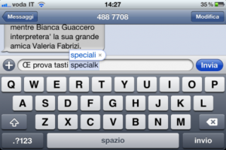
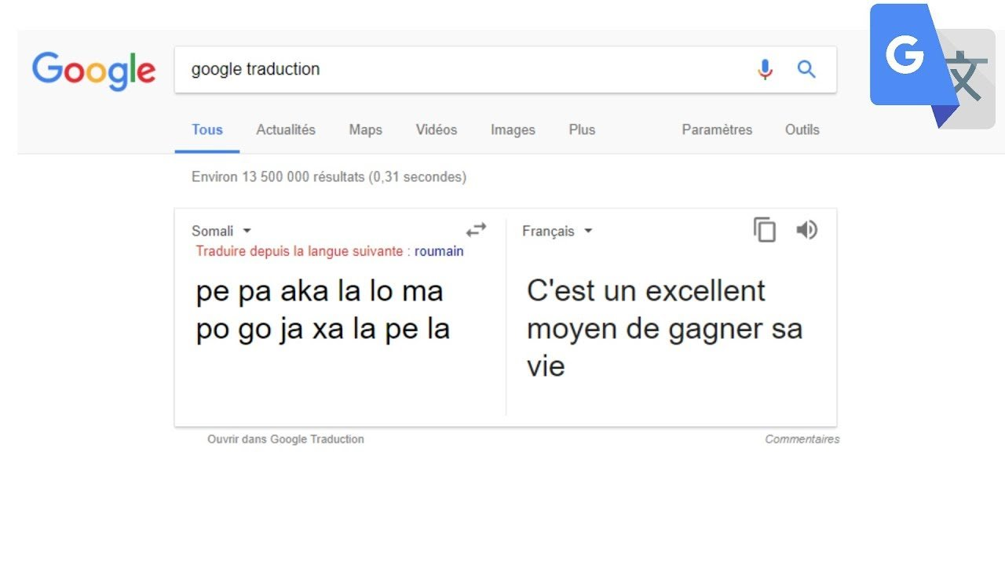
Examples of AI tools that we used all the time. Without even noticing!
Notes:
https://infoidevice.fr/comment-activer-le-clavier-autocorrection-de-lios-5-sans-jailbreak/
https://phys.org/news/2009-03-wolfram-alpha-google.html

Slide 10
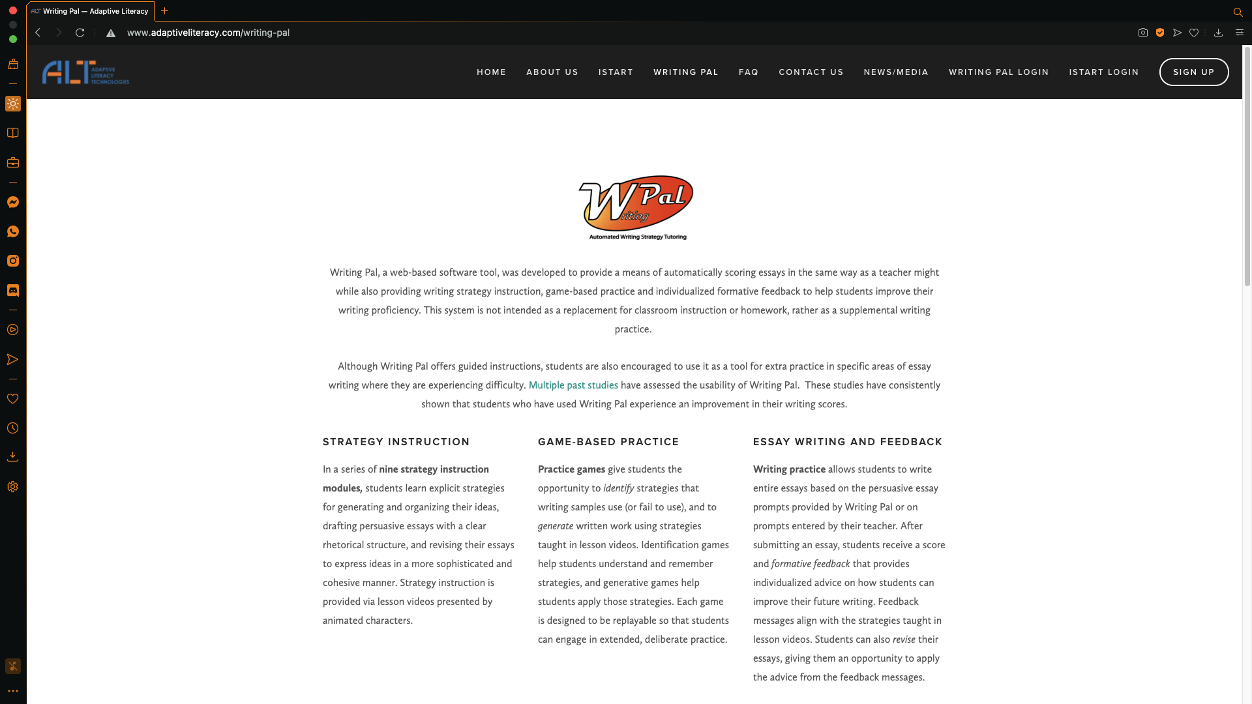
Other tools, to improve your knowledge or skill capabilities, concerning your writing:
Writing Pal
WolframAlpha

Slide 11
But there is a “margin of error”, none of these tools are flawless.
Blade Runner, Ridley Scott, 1982
Doesn’t that remind you of the Alan Turing test?

Slide 12
3. GPT-3
An Artificial Intelligence tool which has numerous capabilities.
But with some shortcomings;
For example, the one to make the AI give the answer of what we ask but not necessarily of what we want.

Slide 13
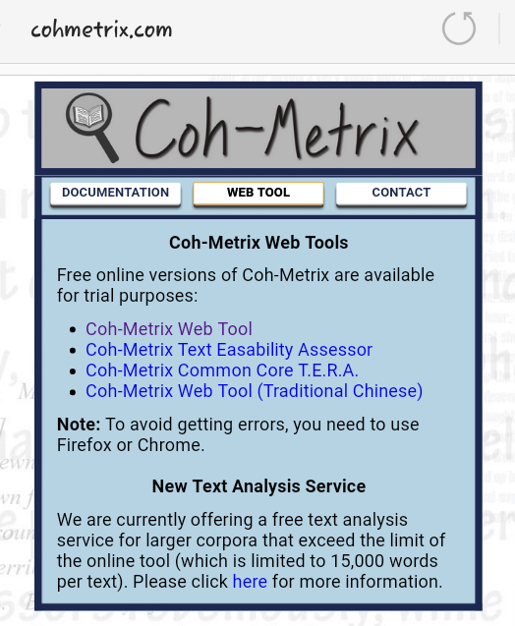
4. Coh-Metrix
One of Coh-Metrix's intentions settles on the subject of the coherence in the mind of the reader.
This tool enables future journalists as you to be helped in choosing the most appropriate words and tone as possible, according to what you want to say, but also according to who you want to be.
Notes:
https://www.researchgate.net/figure/screenshot-of-coh-metrix-30-showing-the-textbox-where-sample-texts-are-inputted_fig2_334046342

