Slide 1
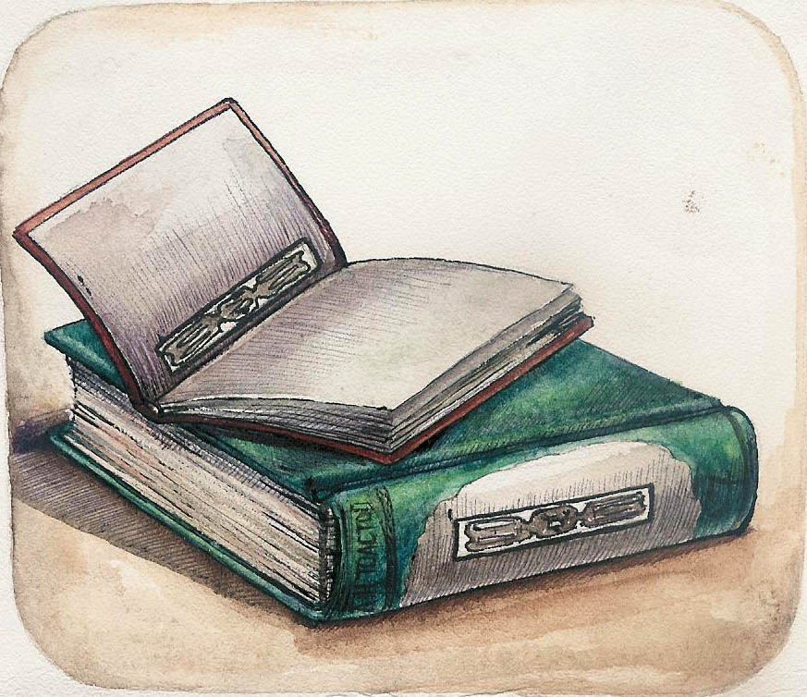
Responsibility behind the words

Slide 2
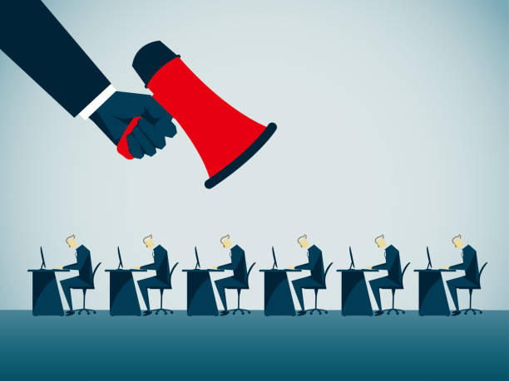
Democracy VS Dictatorship
How can we hope figuring politicians out, and have some clues if the system comes under…
Or
Democracy
Dictatorship
?

Slide 3
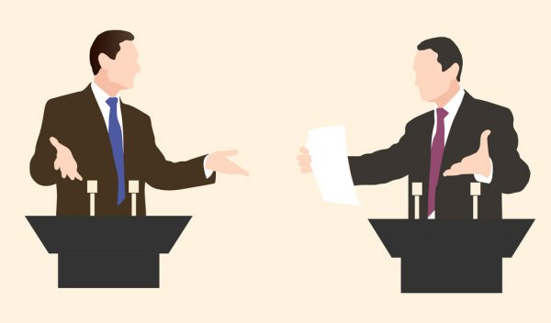
In defining formal/informal language
In analyzing the way of speaking and writing

Slide 4
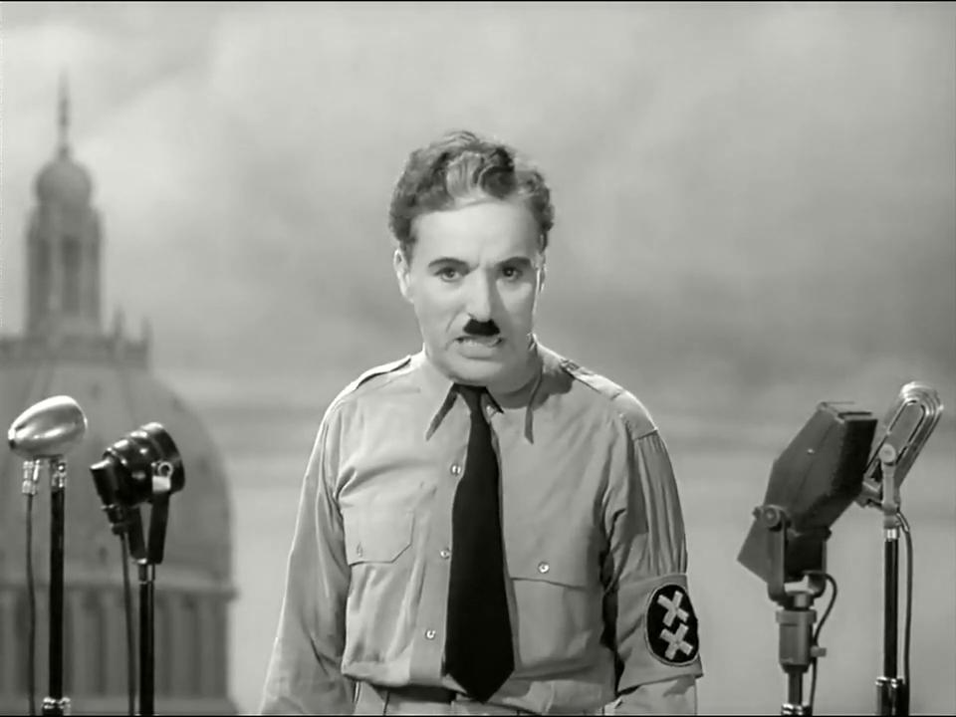
The Dictator, Charlie Chaplin, 1940

Slide 5
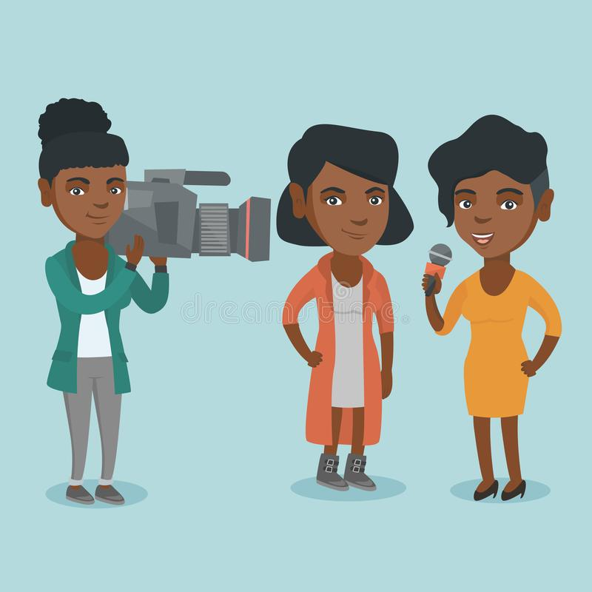
There is also an interrelation between what is said and what is received.
Principle also adjustable to you, future journalists...

Slide 6
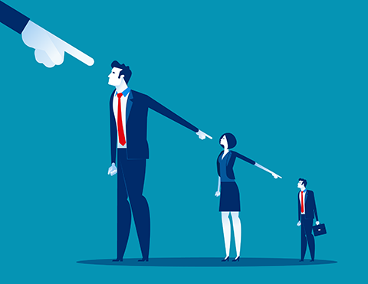
How to become aware of the responsibilities you have?
How to become aware of the extent of your words?

Slide 7
And especially, what is your intention behind the words?

Slide 8
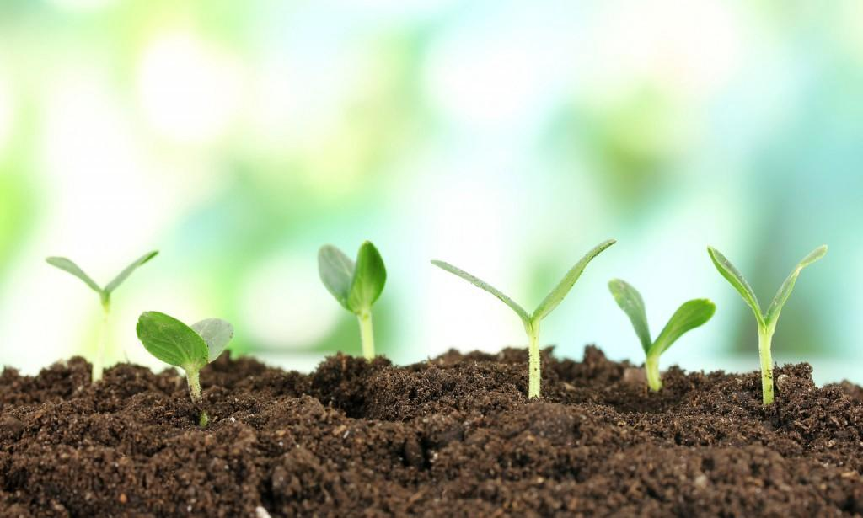
2. Intention behind the words
It is the deep message you want to spread.
The intention is the first spark, first thing that exists before:
giving it a name
being aware of it
and substantiating it.

Slide 9
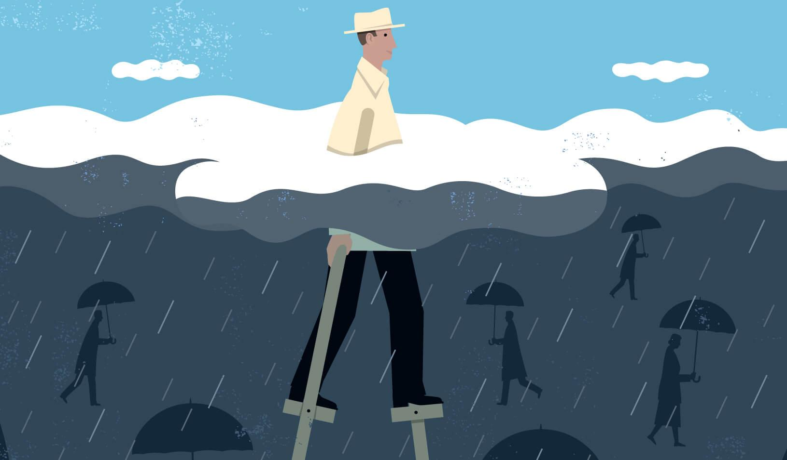
How to make it in harmony with your values?
Chiming with yourself?
How to find it and to be sure it is well defined, before hoping share it?

Slide 10
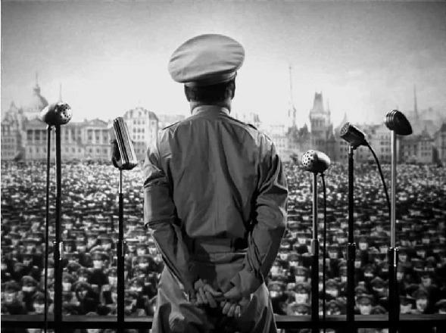
Futures complications that will come out with, because of the Mental Representation...
Whether you want and like it or not, your words will go over what you really wanted to share, deeply.

Slide 11
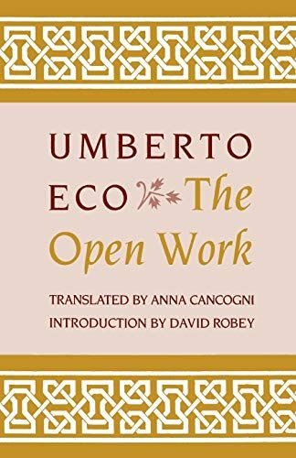
3. The weight of words, out of our control
The lector/spectator embodies, despite himself:
A kind of extension of the film/book.
Enabling it to still exist, and probably forever, by the simple fact of his/her interpretation/emotions/thoughts
The relationship between a work, a movie, a book, and the lector/spectator.

Slide 12
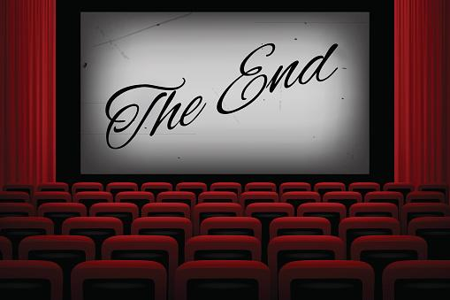
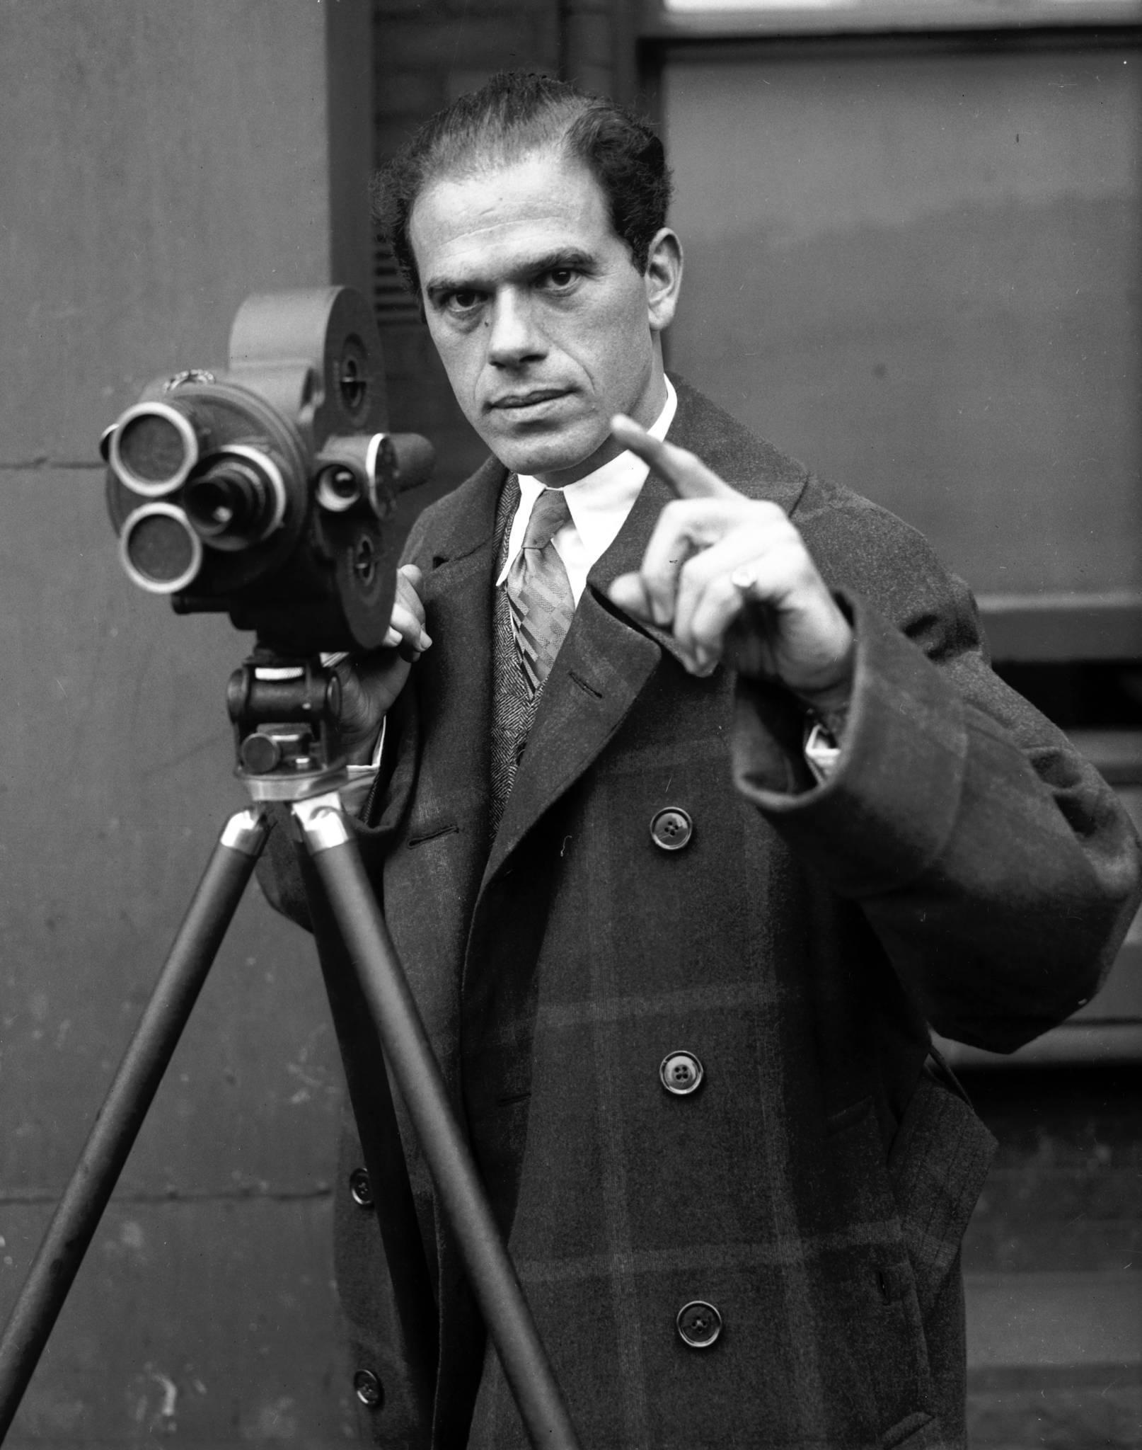
We make it become undying and perpetual, granting it a dimension that it didn’t imagine or even claim.
Not even its creator.

Slide 13
This principle is suitable for Art, work, ideas, project.
But we can make an analogy with words, from the most insignificant to the most relevant and meaningful.
That’s why we talk about Responsibility.
The 3I, by order: Intention - Interpretation - Influence

Slide 14
Conclusion
The intention is the first point on which put the emphasis on; the nerve centre from which ramifications stretches out here and there: so it’s very important to well define it.
A way of speaking or writing can betray the political system, according to the words used, tone and so on: formal language or informal…
Even if the intention is well outlined, no one can have the power to control the influence that the words will have on, because they are inextricably linked with Mental Representation: it is the weight of words, with the faith we decide to put on it, following the example of Art, as highlighted by Umberto Eco.

Slide 15
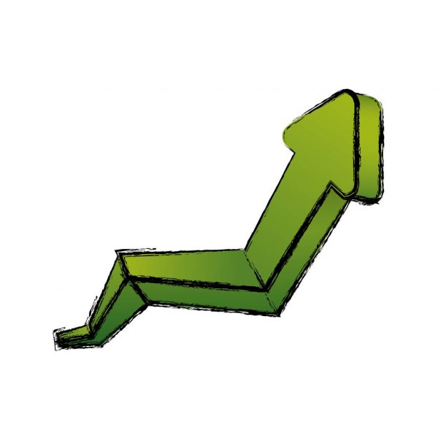
From now on, we are going to study how, precisely because of this ambivalence,
it is easy to mislead people - intentionally or not, in the next chapter.

