Slide 1
Final Task

Slide 2
Examples of processing
Let's do a simple example to approach for the first time with RapidMiner Studio and its operator that you need for processing the texts.
Text processing is the operation used to automate the creation or manipulation of electronic text.
Using a simple file text, we’ll show you the steps to do how to process text in general and learn the tokenization process.
This operator splits the text of a document into a sequence of tokens. There are several options how to specify the splitting points.
At the end you’ll try by yourself to tokenize the text of another and longer text file.

Slide 3
Import the data you have:
it can be a text file as well as a statistics file. In our case we need to import a text file.
Select “My computer”;
only for this case because we have already downloaded the file on our computer

Slide 4
Select the folder where you have saved your file
Select the downloaded file called “Basic+Process.txt” before to analyze through RapidMiner
What are you going to do in this exercise is to read this text file to some basic manipulation just to get your heads around to Rapidminer
Click on “next” until the end, at “finish” to import your data

Slide 5
You can currently notice the presence of your data in your local repository. If you see it, means you made a correct import and open data procedure

Slide 6
It is possible to open and read the file thanks to “Read Document” operator. You can find it in the “Operators” section, it’s easier to use the search bar.
(2)
Drag and drop the “Read Document” operator (1) in the “Process” panel and then (2) select it.
(1)

Slide 7
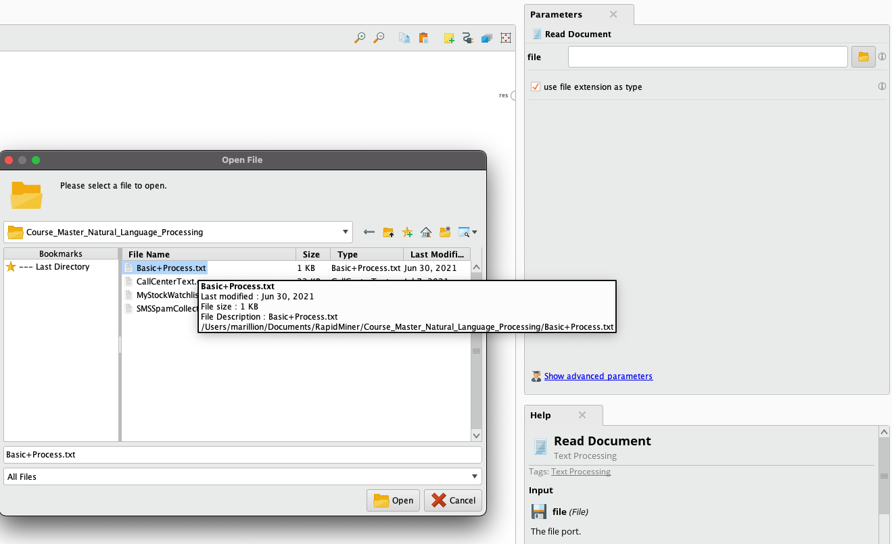
Click there in “Parameters” to browse in the folder you saved the file
Select the file “Basic+Process” downloaded before
And open it

Slide 8
1
Connect the output and the result points together, clicking and dragging from the first to the second one.
Then release to see the connecting line and if you want also to see the output printed later when we will run the process.
2

Slide 9
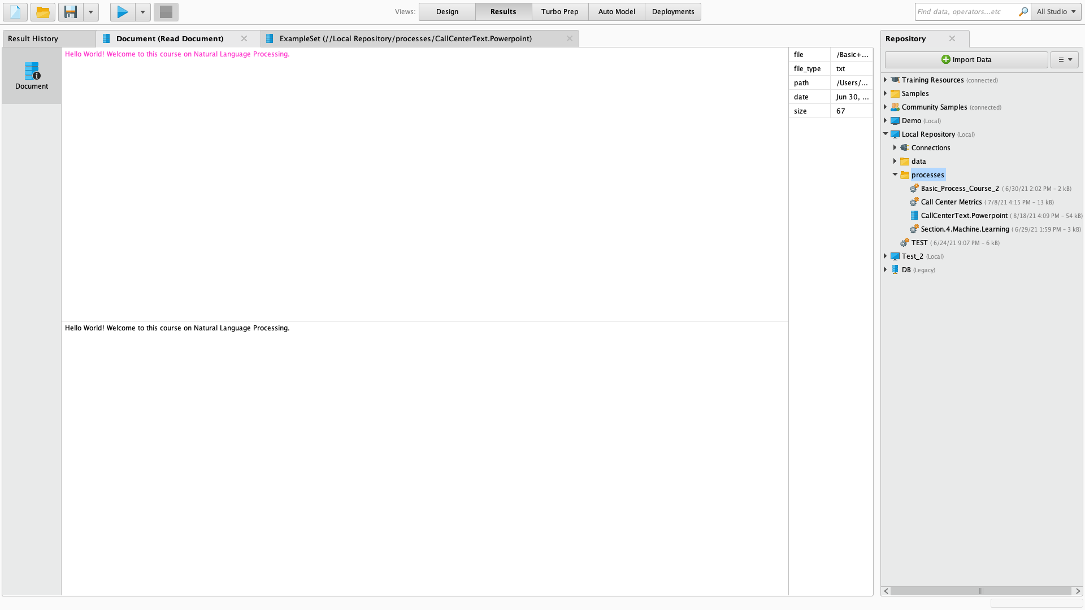
Now let's run this process.
The “Results view”:
The results of that is showing a couple of different pins text here in the top and pink.
The same text here in the bottom black.

Slide 10
The “tokenize” operator
Search for “tokenize” operator
Drag and drop it inside the Canvas

Slide 11
After you have inserted new operators, you can interconnect the operators inserted as shown, where the results of test will be transferred to Tokenize in the form of document.
1
Delete the link there
Connect the 2 operators
Reconnect “Tokenize” with the other output
And run the process!
2
3
4

Slide 12
You can see how the top and bottom looks different. In the bottom you can see the initial sentence with the exclamation symbol and the full stop at the end.
After tokenization, on top, you can see this the output of the tokenize operator where it removed all the punctuation tokens each and every individual word.
Basically it’s a color coding that show you the tokenized text here and nothing has changed.

Slide 13
“Extract length” operator
So next what we are going to do is extract the length of our document or text document
and add that data to the Process itself using Extra Length operator.
Search for “Extract Length” operator.
Cut the link that connect the output and the result;
Drag and drop the Extract Length into the Process.

Slide 14
Connect “Tokenize” with “Extract length” operator by the doc connection;
Do the same with the “Extract length” connecting it to the result.
Run the process.

Slide 15
At first view the result could be the same but check on the right of it in the table of properties.
A new row has been added: it is the number of the characters after tokenization with no spaces count.

Slide 16
Let’s try yourself!
Now that you know how to execute processing text, try yourself with the following example file text:
New York Times Web News

